Slide 1

PMAANZ
Update
Primary Health Dataset Programme (PHDP)
Stephen Lavery
Tony Cooke

Slide 2
Compelling context
Waitangi Tribunal findings from the Health Services and Outcomes Inquiry (Wai 2575)
improved outcomes for Māori.
Health and Disability system review
Focus on equity of outcomes
New Health structures, new opportunities to work in partnership

Slide 3
Why a primary care dataset?
data is held in lots of places – it’s not joined up
so how can a system plan and allocate and invest without relevant population level data?
general practice, community providers and PHOs have built data sets locally

Slide 4
Benefits for population
quality of care
health equity for priority populations
stronger collaboration with primary and community care
integrates with the wider digital ecosystem
improved governance of primary and community healthcare data including Māori data sovereignty

Slide 5
Benefits to community providers
a more complete set of primary health information
provides the evidence for you to design services for your populations
can provide data where there is a data sharing agreement
Te Whatu Ora is the custodian of the data and will facilitate its curation
this data provides the evidence needed to ensure equity of services and achieve pae ora

Slide 6
Challenging journey
a programme started in 2016
work was undertaken by the primary care sector to progress
parties were not aligned on the “how” and “where”
a new approach was initiated in 2019
this was delayed due to the development of nHIP (precursor to Hira) and COVID-19
there is an opportunity to deliver much needed capability in partnership with the sector

Slide 7
PHDP approach
broad sector engagement
strong governance with acknowledged leaders in the sector
combine sector capability with Ministry, Te Whatu Ora and Te Aka Whai Ora scale and resources
connect siloed data platforms, analytical expertise, and communities of interest

Slide 8
Timing and objectives
9-12 months
  sector collaboration on the data
  assembly of the data
  development of technical architecture to enable assembly data
  partners in the development

Slide 9
We are not starting from scratch
data is held in lots of places – it’s not joined up
so how can a system plan and allocate and invest without relevant population level data?
general practice, PHOs and Māori health providers have built data sets locally

Slide 10
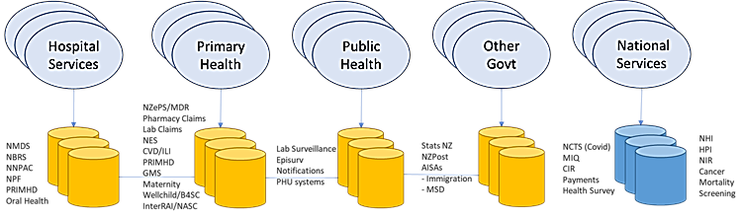
Data available nationally

Slide 11
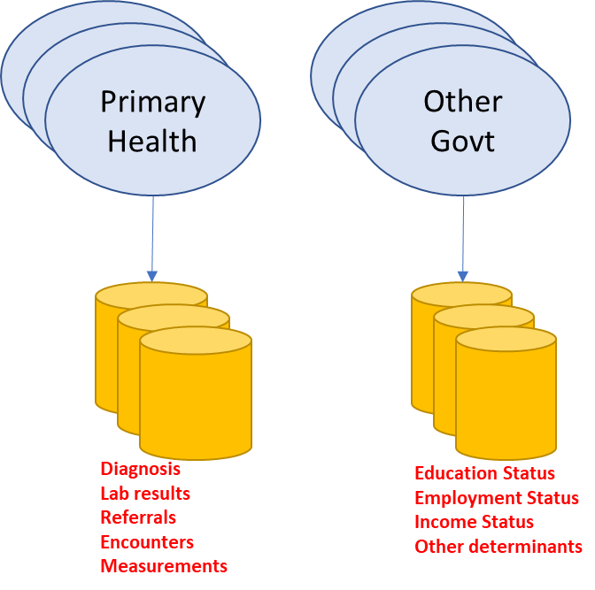
Data not available nationally

Slide 12
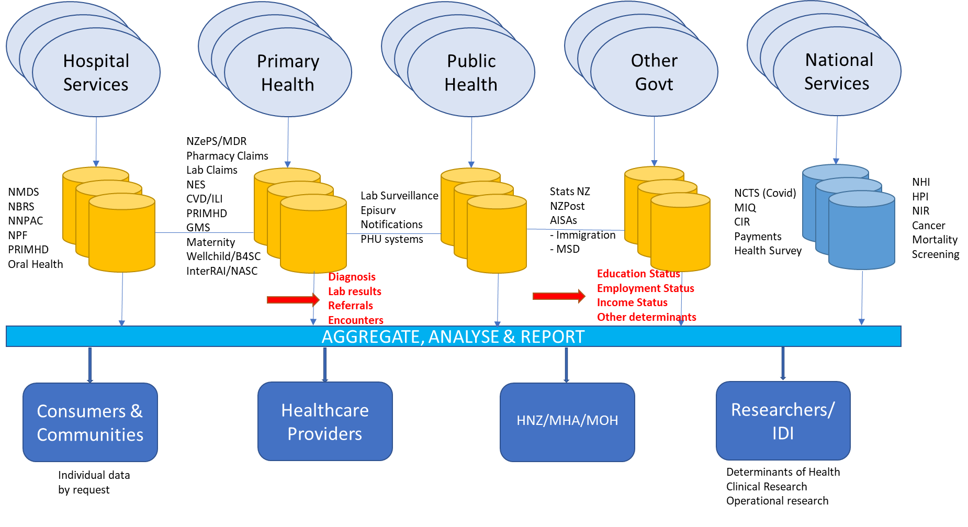
Objective

Slide 13
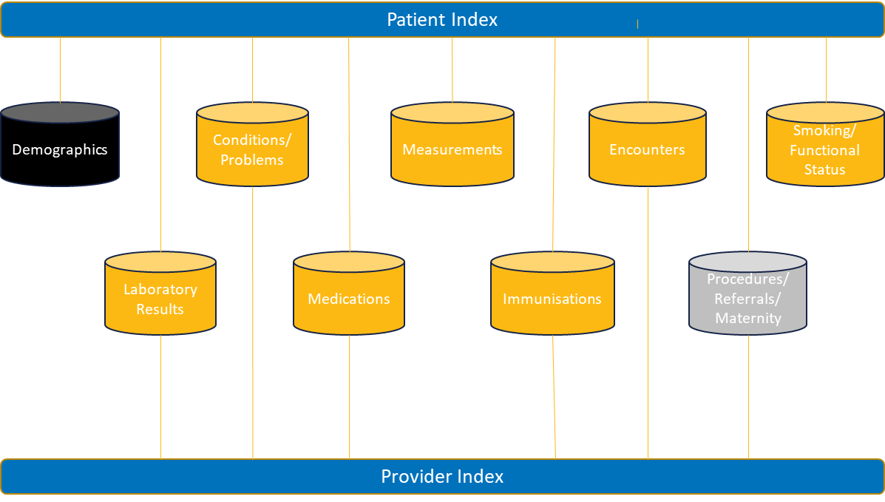
Proposed data domains

Slide 14


Slide 15
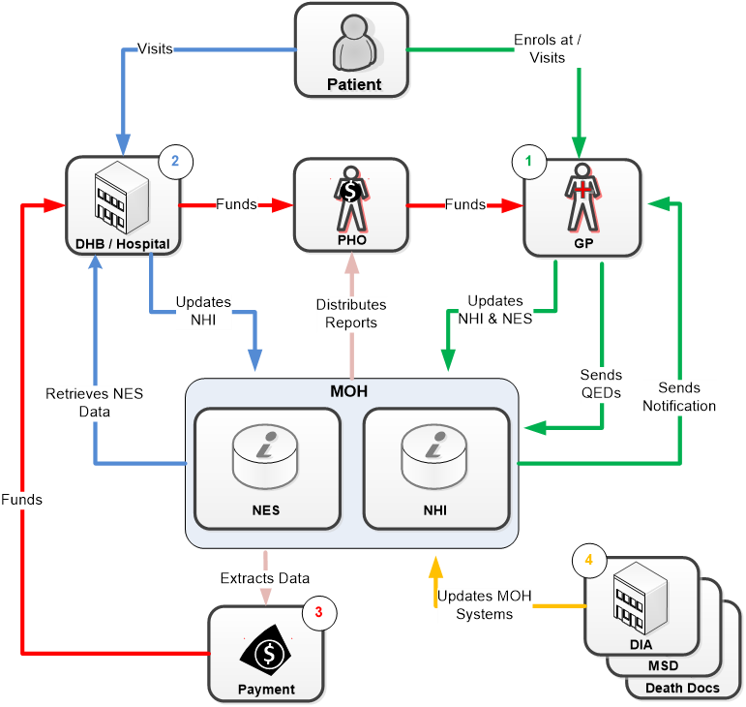
NES

Slide 16
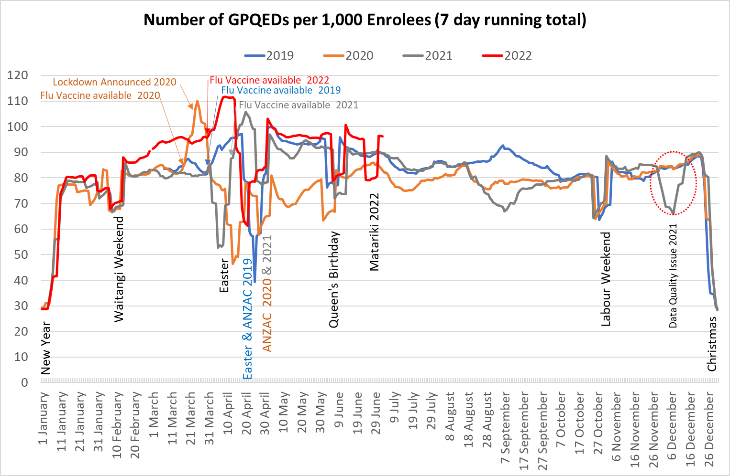
Covid-19 impact total population

Slide 17
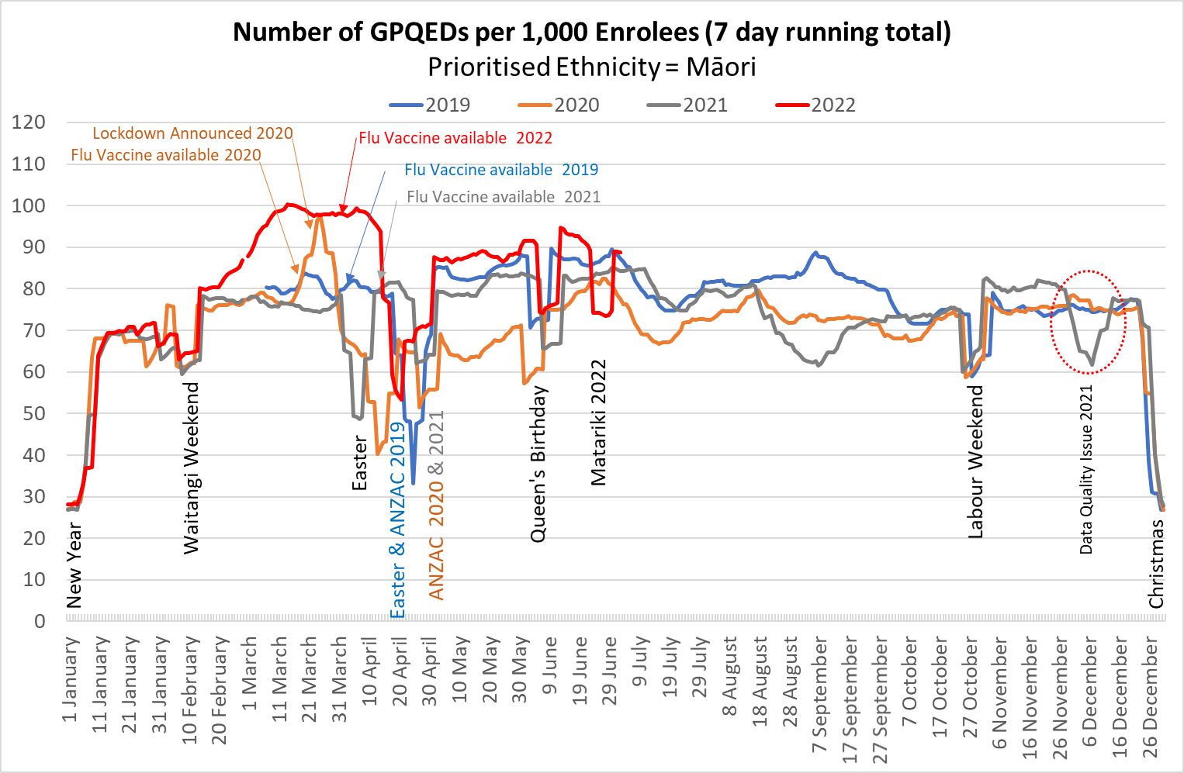
Covid-19 impact - Māori

Slide 18
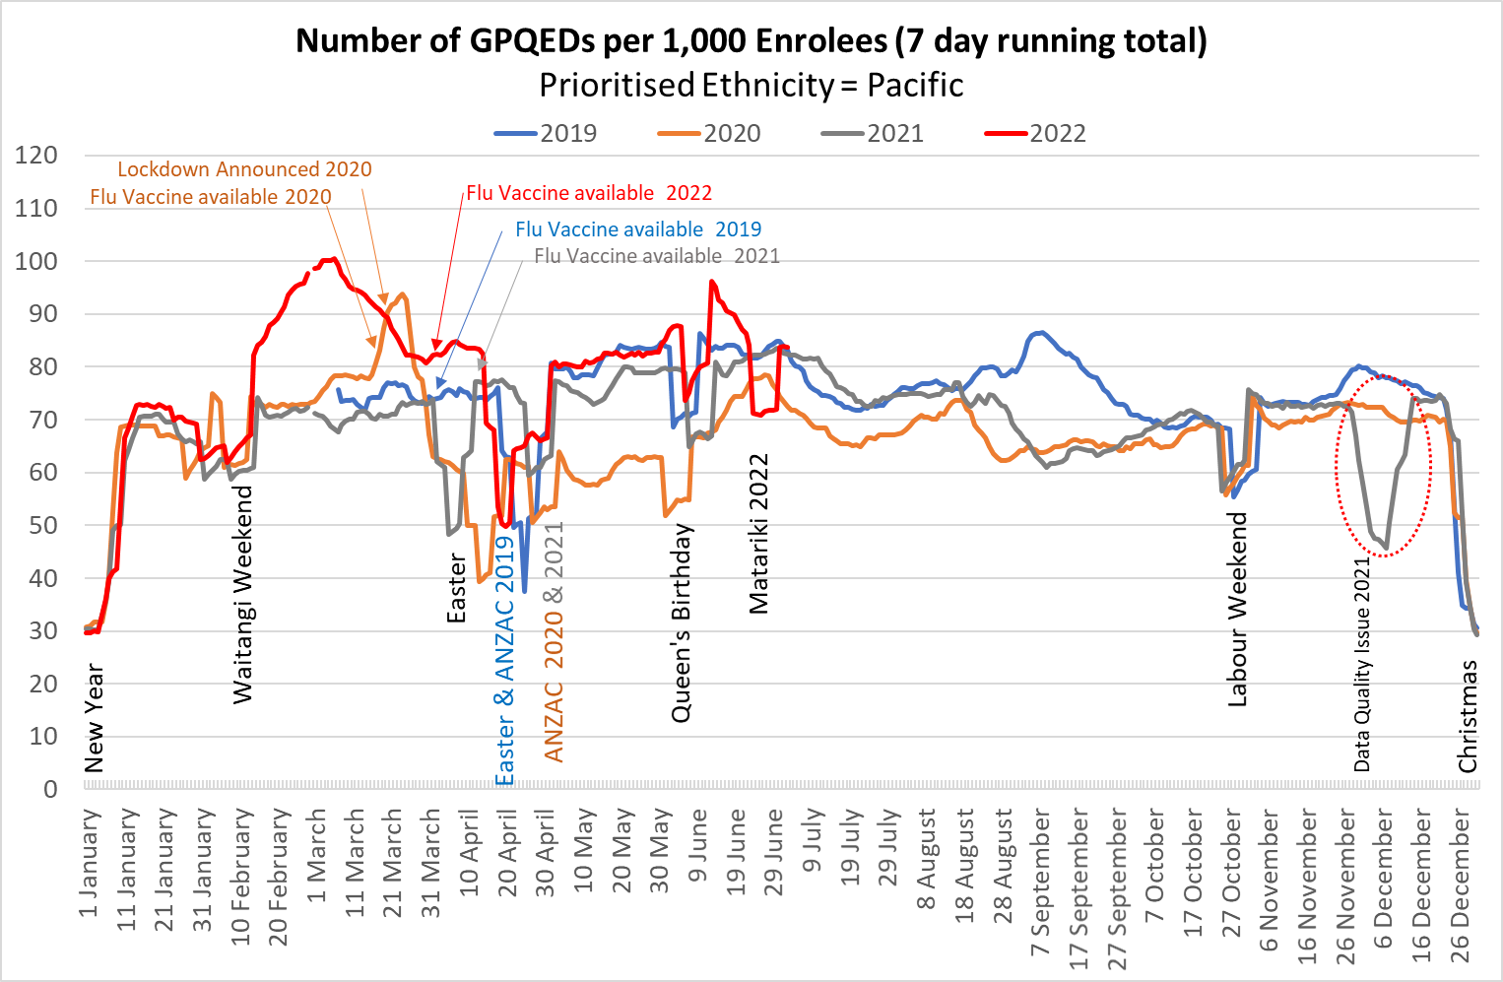
Covid-19 impact - Pacific

Slide 19
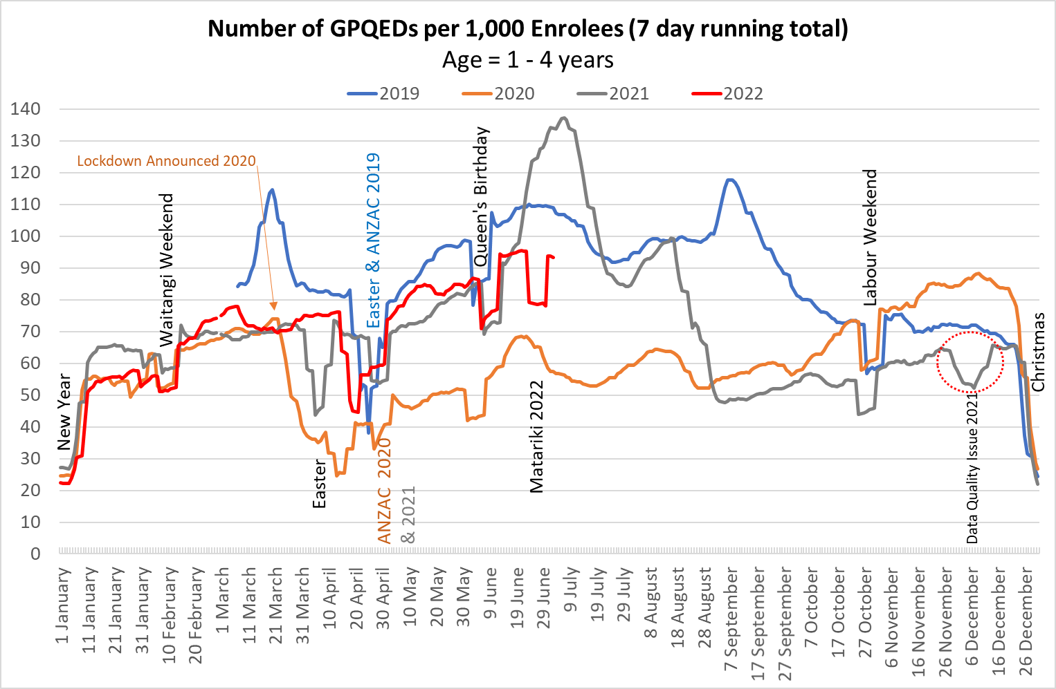
Covid-19 impact - 0 - 4 years

Slide 20
Where does PDHP fit with Hira?

Slide 21
A few questions for you?
Do you think that existing primary care datasets can be used as the basis for a national view?
Where does PMAANZ see yourselves in this work?
What should change this end?
Have we missed anything?
How can we best work together?

Slide 22


