Slide 1
Flu 2023|Book My Vaccine - What it is and who needs to sign up
Book My vaccine (BMV) is enabled to support the 2023 Flu Campaign
WHAT IS BOOK MY VACCINE:
Book My Vaccine is a booking tool that connects consumers and vaccine providers together.
Consumers can view locations and select an appointment time that works for them.
Providers use the system to manage appointment schedules and availability.
WHO NEEDS TO SIGN UP AND WHY:
Providers delivering publicly flu and/or COVID vaccines to casual or non-enrolled consumers should use Book My Vaccine to manage and display booking availability at their site(s).

Slide 2
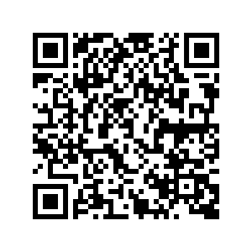
Flu 2023| Book My Vaccine - How do I sign-up
Book My vaccine (BMV) is enabled to support the 2023 Flu Campaign
HOW DO I SIGN UP:
Providers that wish to sign up to use Book My Vaccine should request a site and user set up form from help@imms.min.health.nz or visit https://www.tewhatuora.govt.nz/our-health-system/digital-health/book-my-vaccine.
Providers should complete the form and send back to help@imms.min.health.nz. Please allow at least 3 working days for the site and users to be set up.
FOR MORE INFORMATION
Provider Book My Vaccine webpage:
https://www.tewhatuora.govt.nz/our-health-system/digital-health/book-my-vaccine/

Slide 3
Book My Vaccine | Flu booking numbers (including flu & COVID-19 vaccines at the same appointment)
Numbers accurate as at 9:30AM 23 March, 2023.
Since BMV was updated on 16 March there have been 1,548 flu booking + flu and Covid-19 vaccines booked at the same appointment.
There are 1,352 active flu bookings of which 62% are for individuals and 38% are booked as part of a group.
81% of bookings are for flu plus Covid-19 vaccine appointments.
19% are flu only.
Prior to 1 April a smaller number of sites will be available to be book (approx. 70) with approximately 380 sites becoming available from the 1 April 2023.
88% of these locations have active bookings

